Slide 1

Utsav Jitendrabhai Patel N01516259 Business Intelligence
Project Name
Toronto Traffic Data Analysis

Slide 2
Introduction
It consists of several records, each representing a unique traffic accident incident. The dataset includes various attributes, such as accident location (latitude and longitude), date and time of occurrence, road class, accident classification (fatal, injury, property damage only), involved parties (drivers, pedestrians, cyclists), vehicle types, weather conditions, and more.

Slide 3
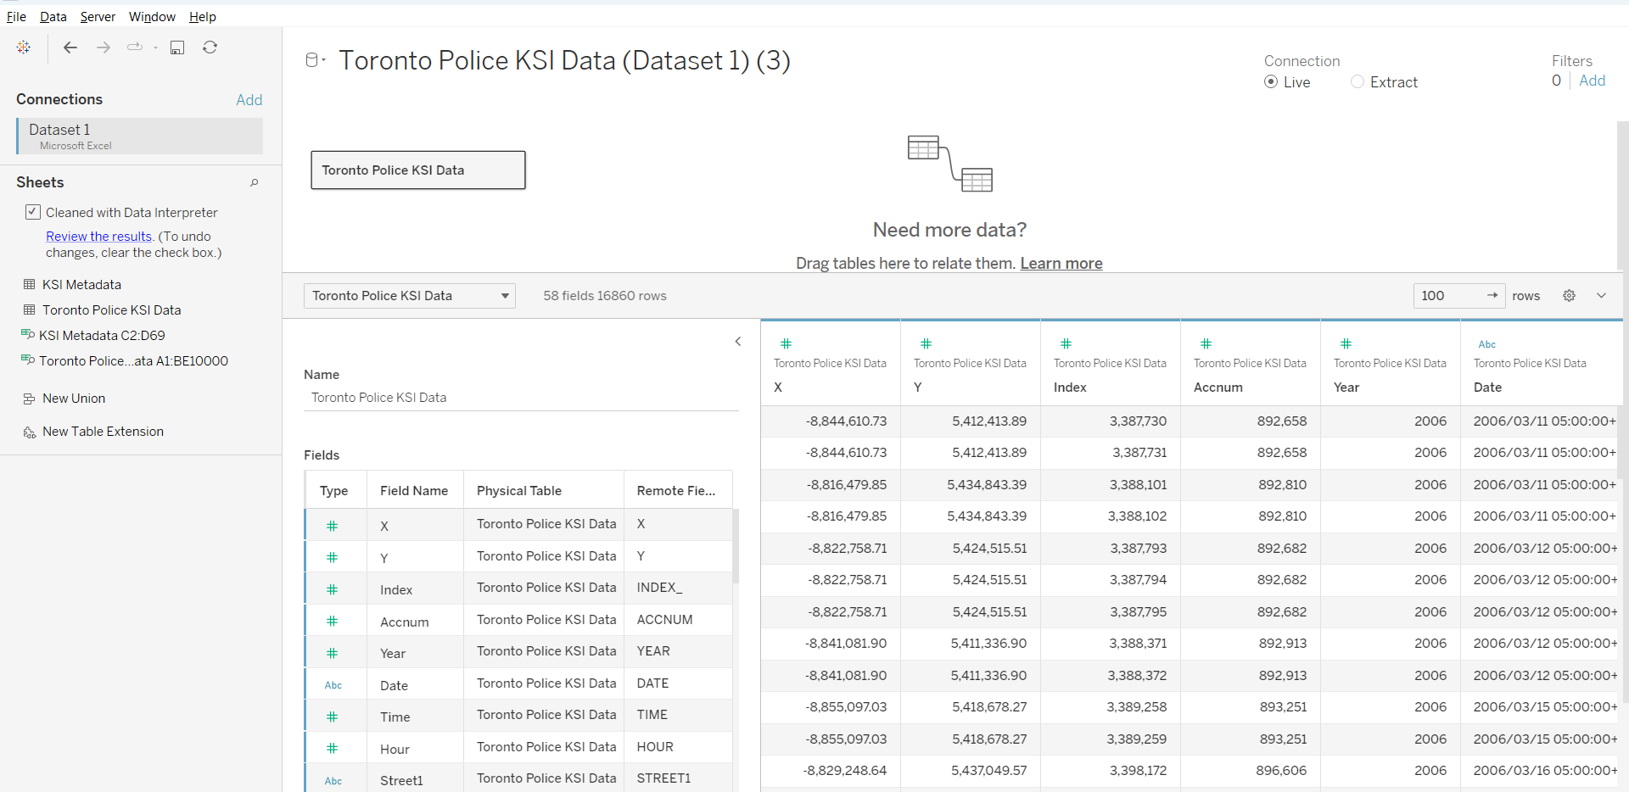
Pre-Processing
It consists of several records, each representing a unique traffic accident incident. The dataset includes various attributes, such as accident location (latitude and longitude), date and time of occurrence, road class, accident classification (fatal, injury, property damage only), involved parties (drivers, pedestrians, cyclists), vehicle types, weather conditions, and more.

Slide 4
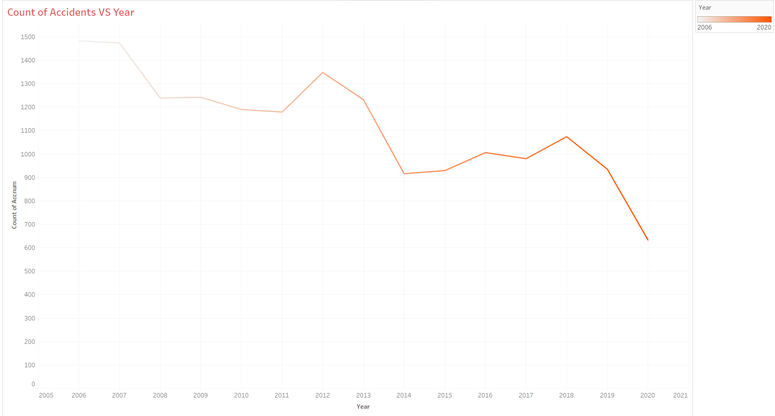
Line graph Count of Accidents VS Year

Slide 5
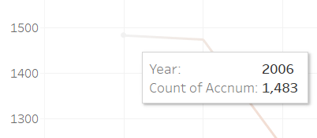
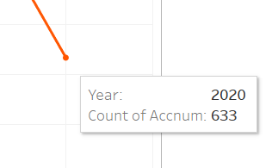
The line chart will display the trend of the count of accidents over the years. This visualization is particularly useful for identifying trends in accident occurrences. The highest Accident I found by visualization in 2006 and the number is 2006. The Lowest Accident in 2020 and the number is 633.

Slide 6
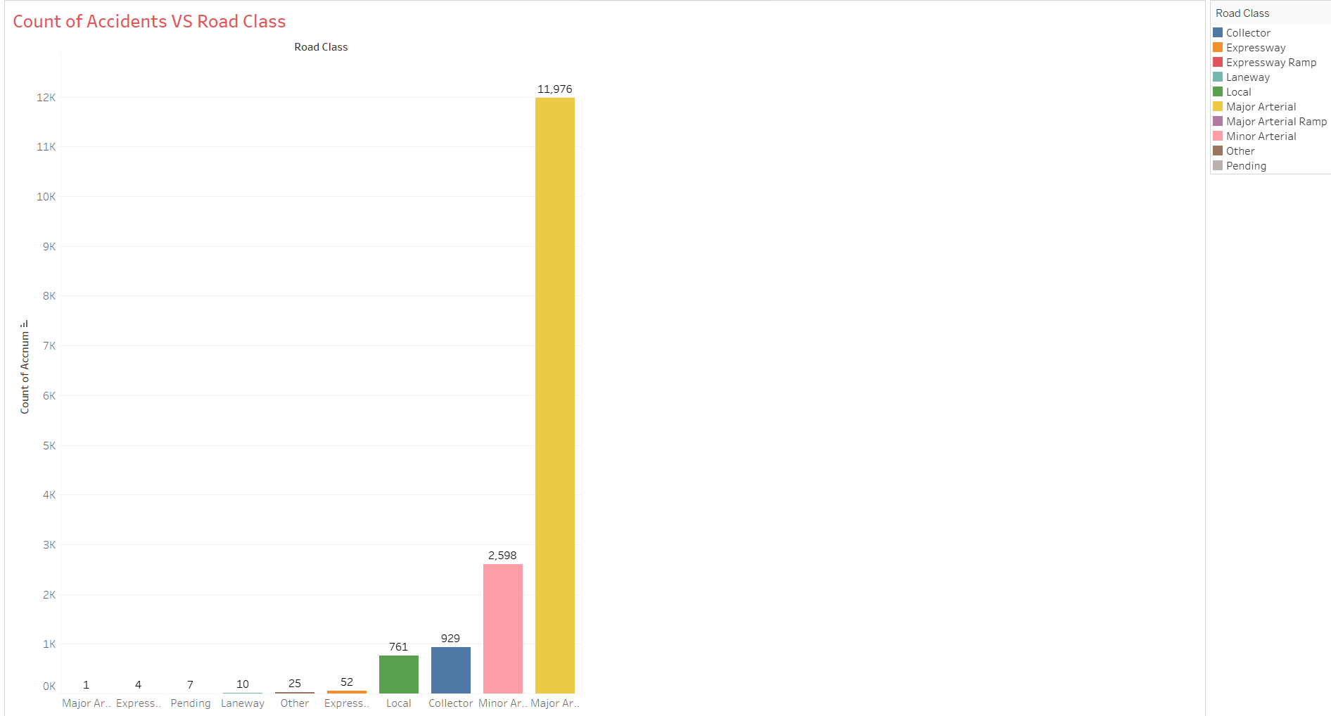
bar graph of Count of Accidents VS Road Class

Slide 7
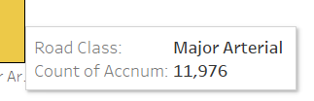
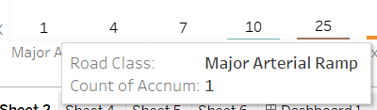
The bar graph showcases the number of traffic accidents recorded for each road class over the analyzed period. The x-axis represents the road classes, while the y-axis displays the count of accidents. Each bar in the graph represents a road class category, and its height corresponds to the number of accidents attributed to that particular road class. The highest Accident I found in major arterial the number is 2006. The Lowest Accident in Major Arterial.

Slide 8
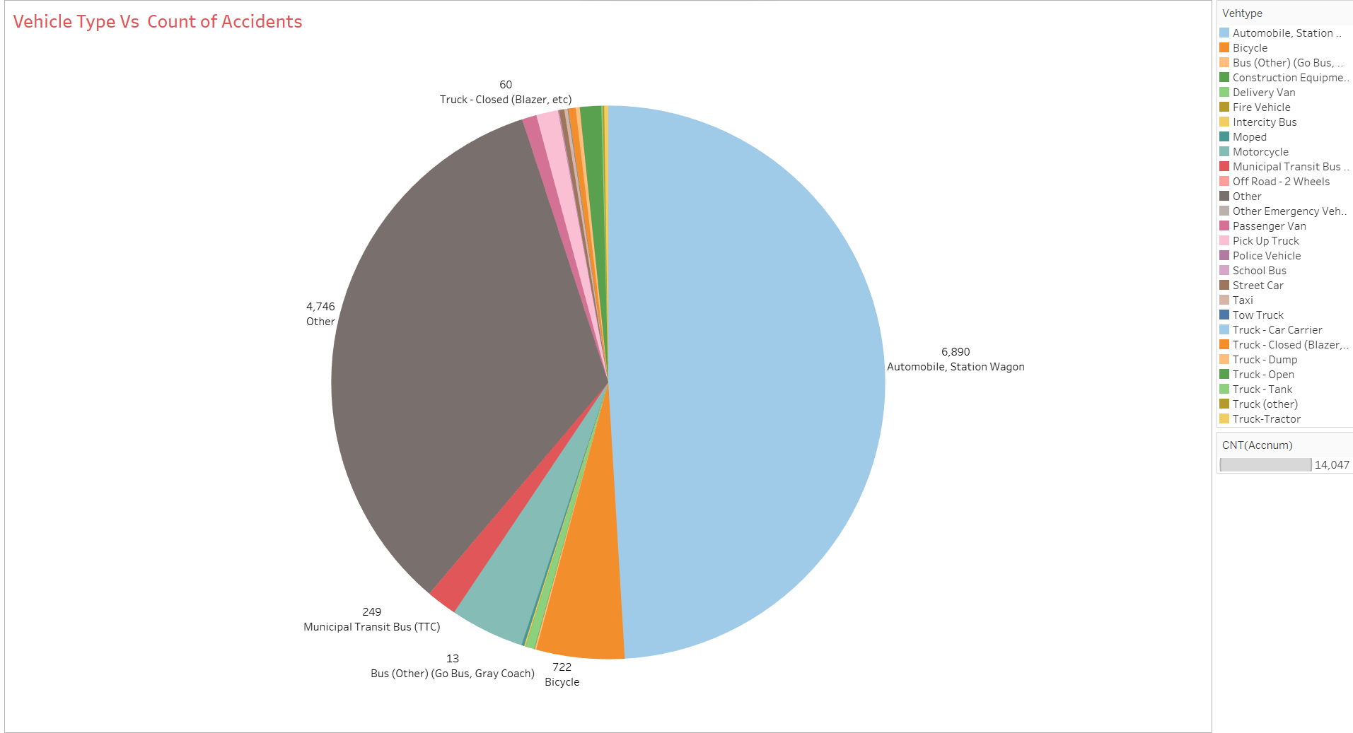
pie chart of Vehicle Type Vs Count of Accidents

Slide 9
In this visualization, we present the distribution of traffic accidents across various vehicle types. Each slice of the pie represents a specific vehicle category, and its size corresponds to the proportion of accidents involving that particular type of vehicle. The chart showcases a holistic view of how different vehicle types contribute to the total accident count. Automobile, Station Wagon is causing major accidents 6890.

Slide 10
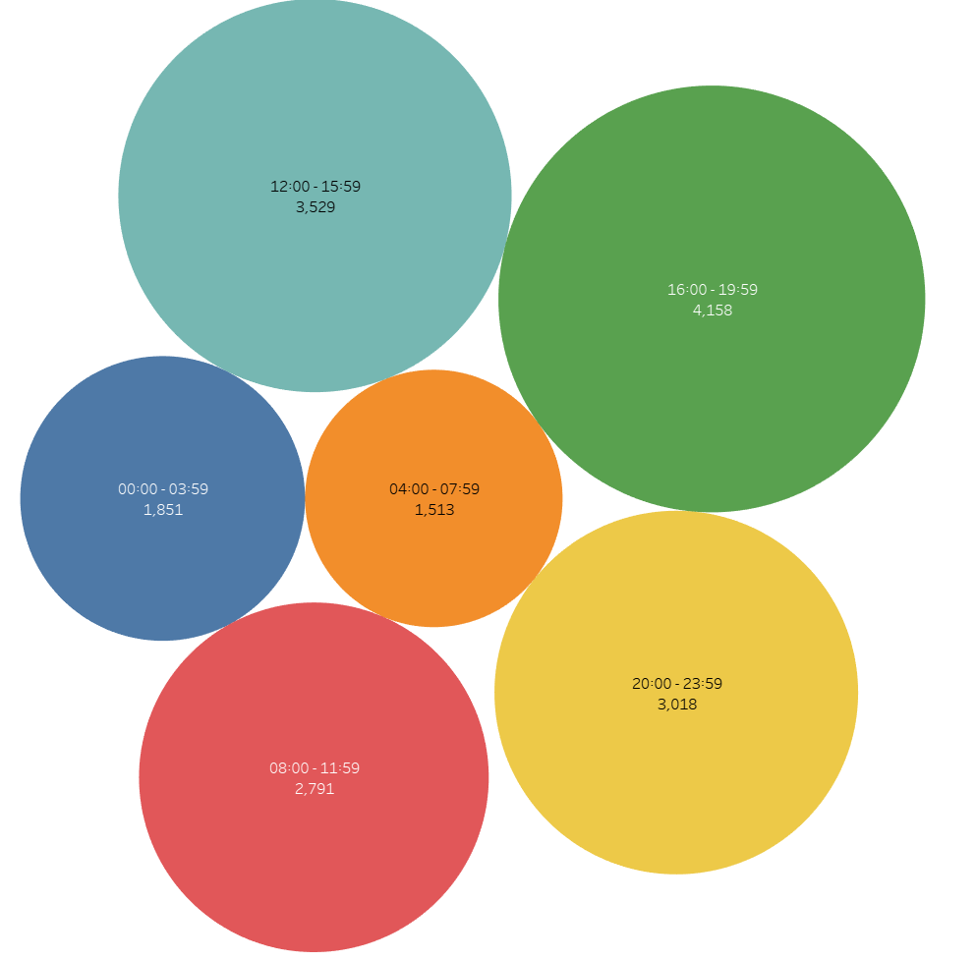
Packed bubble chart of Number of Accidents in Particular Time Slot

Slide 11
The bubbles are color-coded to distinguish between different time slots, making it effortless to identify peak periods of accidents during the day. Additionally, hovering over each bubble provides precise information about the start and end times of the time slot, as well as the exact count of accidents for that particular period. The highest number of Accidents in the 16.00-19.59 time slot and the number of accidents are 4158. The lowest number of Accidents is in the 4.00-7.59 time slot and the number of accidents is 1513.

Slide 12
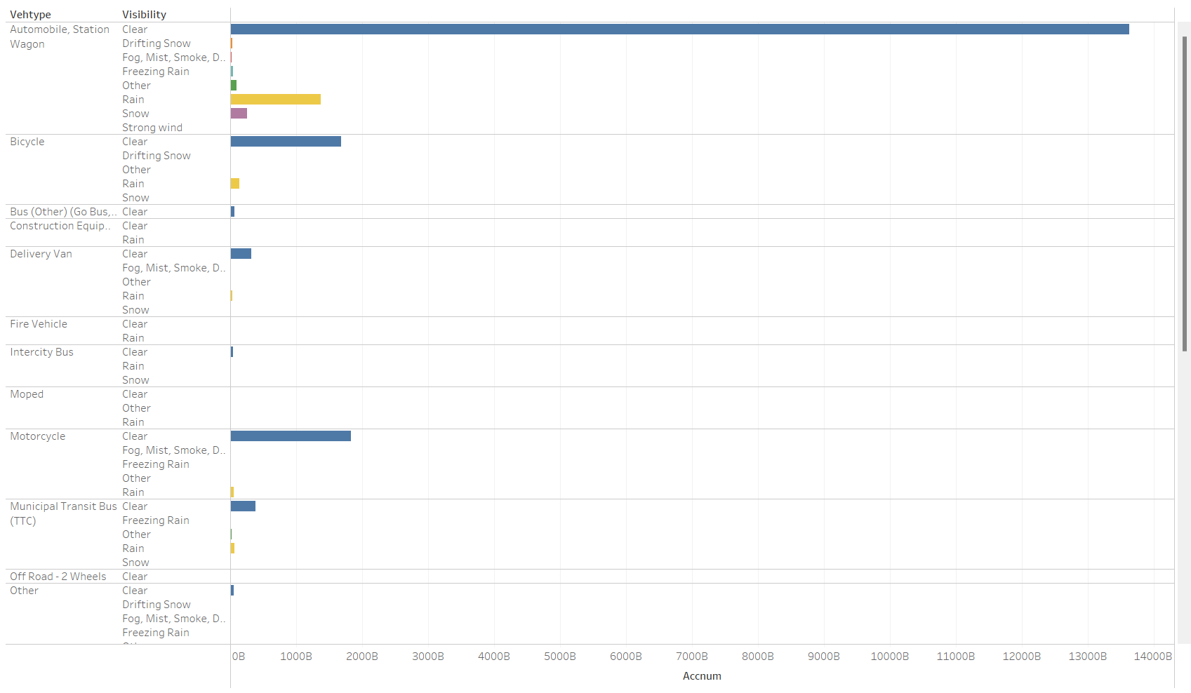
Horizontal Bar graph of Accidents VS Vehicle Type and Visibility

Slide 13
The bars are color-coded to differentiate between vehicle types, allowing for easy identification of the most accident-prone categories. Additionally, each set of bars is labeled with the visibility condition, making it straightforward to identify trends and patterns related to visibility impact on accident frequencies.

Slide 14
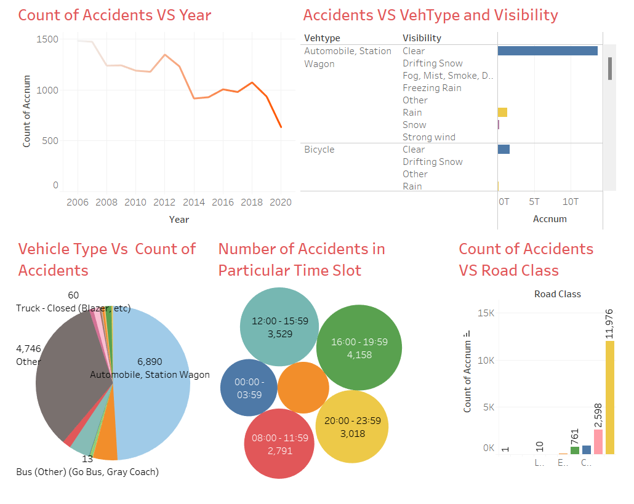
Dashboard: Visual representation of attributes that can cause the accidents

Slide 15
conclusion
Hammering the last nail, during the evening rush hour (16:00 - 19:59), accidents occurred on major arterial roads involving automobiles with clear vision conditions in 2006.
What can we do to overcome the problem?
These findings underscore the significance of addressing traffic safety measures during peak commuting hours to mitigate accidents and improve overall road safety. By understanding the specific conditions and areas where accidents are more likely to happen, targeted interventions and awareness campaigns can be implemented to create safer roads for everyone. Let's work together to make our streets safer and accident-free!

Slide 16
Thank You!

